Slide 1

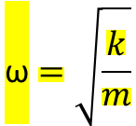
Periodic Motion:
If the motion of a body is such that it crosses from the same direction a particular point in its path of motion at regular interval, then the motion is called periodic motion or harmonic motion.
Simple Harmonic Motion :
If acceleration of a body executing periodic motion acts along a fixed point in its path of motion in a such a way that its magnitude from that point is proportional to its displacement, then the motion of the body is called Simple Harmonic Motion.
$$\text{ω}=\sqrt{\frac{k}{m}}$$
Time Period T = 𝟏 /𝒇
Angular Frequency ω=2πf
Frequency f=1/T
spring constant k = m ω^2

Slide 2





ENERGY IN SIMPLE HARMONIC MOTION
Mechanical Energy = Kinetic Energy + Potential Energy = constant
Potential Energy (elastic potential energy)
Kinetic Energy
Mechanical Energy

Slide 3



Simple Harmonic Motion and Uniform Circular Motion:
Simple harmonic motion is the projection of uniform circular motion on a diameter of the circle in which the circular motion occurs.
Position
Velocity
Acceleration

Slide 4

Damped Simple Harmonic Motion
When the motion of an oscillator reduces due to an external force, the oscillator and its motion are damped.
Damped 𝑚𝑒𝑐ℎ𝑎𝑛𝑖𝑐𝑎𝑙 𝑒𝑛𝑒𝑟𝑔𝑦:
Unit Damping b = kg/s
𝑇ℎ𝑒 𝑚𝑒𝑐ℎ𝑎𝑛𝑖𝑐𝑎𝑙 𝑒𝑛𝑒𝑟𝑔𝑦 𝑓𝑜𝑟 𝑎 𝑑𝑎𝑚𝑝𝑒𝑑 𝑜𝑠𝑐𝑖𝑙𝑙𝑎𝑡𝑜r

Slide 5
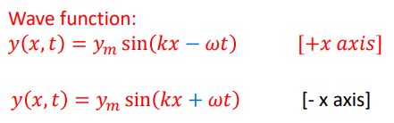




Transverse wave: Vibration of particles of the string perpendicular to the velocity of the propagation of wave
Longitudinal wave: Vibration of the particle of air parallel to velocity of the propagation of wave
Sinusoidal Function:
Wavelength= 𝜆
A sine function begins to repeat itself when its angle (or argument) is increased by 𝑘𝜆 = 2𝜋 𝑟𝑎𝑑
When wave moves positive direction of x
When wave positive negative direction of x
moving in the positive direction of x, wave speed

Slide 6





𝜇 = linear density of the string
τ = tension in the string
Radial restoring force: F=
Centripetal acceleration

Slide 7
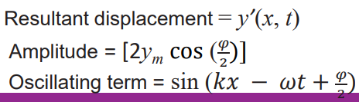

Superposition Waves :
When two sinusoidal waves of the same wavelength and amplitude in the opposite direction along a stretched string is called Superposition Waves.
Interference of Waves:
Suppose we send two sinusoidal waves of the same wavelength and amplitude in the same direction along a stretched string.

Slide 8
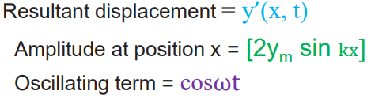

Standing Waves:
If two sinusoidal waves of the same amplitude and wavelength travel in opposite directions along a stretched string, their interference with each other produces a standing wave
Nodes: The string never moves. The amplitude of the resultant wave will be zero. Nodes points never oscillate
Antinodes: The halfway between nodes are called antinodes, where the amplitude of the resultant wave will be maximum. Antinodes points oscillate the most.

Slide 9


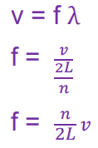

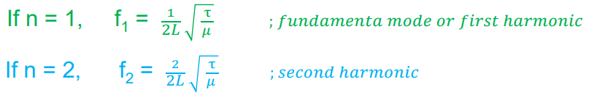

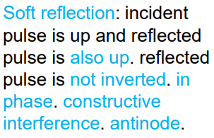
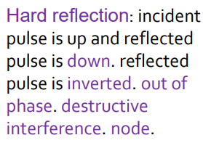



wavelength

Slide 10

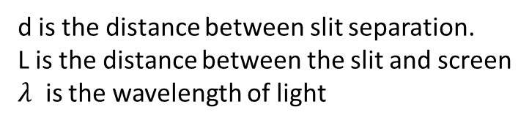
Wave front: The wave front of a time-varying field is the set of all points where the wave has the same phase.
Huygens’ wave theory is based on a geometrical construction that allows us to tell where a given wave front will be at any time in the future if we know its present position. Huygens’ principle is:
All points on a wave front serve as point sources of spherical secondary wavelets. After a time t the new position of the wave front will be that of a surface tangent to these secondary wavelets.
YOUNG’S INTERFERENCE EXPERIMENT:
To form Interference, the incident light satisfy two conditions:
(1) Monochromatic source: Light consists of one colour or one wavelength.
(2) Coherent source: Plane waves from the monochromatic source maintain a constant phase relation. If two waves are out of phase, this phase difference must not change with time.
Path length difference , ΔL = d sinθ
Distance between fringes
d is the distance between slit separation.
L is the distance between the slit and screen
$λ$ is the wavelength of light

Slide 11









Incoherent Sources:
If the phase difference between the waves emitted by the sources varies randomly then the sources are called incoherent sources.
Coherent Sources:
If the phase difference between the waves emitted by the sources remains constant then the sources are called coherent sources.
Intensity in Double-Slit Interference:
Condition for Intensity
Maxima
Minima
the phase difference,
I= Intensity

Slide 12






Intensity in Double-Slit Interference without phasor.
intensity I that is proportional to 𝐸^2, intensity
Phase difference 𝜑:

Slide 13
General Equation of Diffraction Minima by a Single-Slit:
Width of the slit = a
𝝀 = wavelength
For the first minima,
The general equation of diffraction Minima is, 𝒂 𝒔𝒊𝒏 𝜽 = 𝒎𝝀 [ 𝒎 = 𝟏, 𝟐, 𝟑 … … … ]

